Slide 1







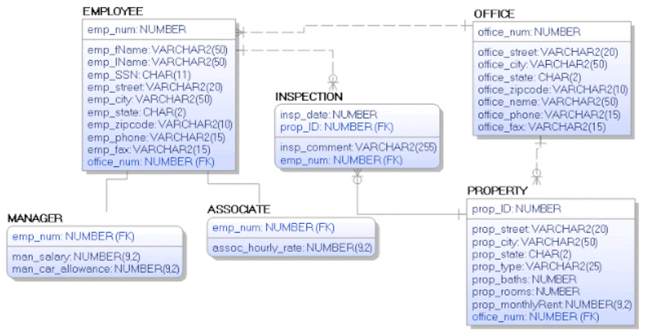

Data Architecture Flow
Data Sources
Data Engineering & Architecting
End-User Enablement
EDW
Batch Load
Cloud Function
Storage based Trigger
Dashboards
CRM
GCP Integration Server
Batch Pipeline
Batch Pipeline
Tables & Views
Cloud Storage
Big Query
Data Exploration
FMW
Landing Zone
Cleaning
Casting
Filtering
Aggregating
Machine Learning
Staging Zone
Analytic Mart Zone
Designing Data Model
Of Mart
Transformation
KPI Calculation

